Slide 1
Week 10: Safety, Security & Modern Computing
Lectures 19-20 — Data Protection, Cloud, VR/AR, IoT & Beyond
Computing Fundamentals · Week 10 · 2026

Slide 2
Contents
01
Lecture 19: Safety and Security
Threats to Data · Protection of Data · Encryption · Best Practices
02
Lecture 20: Modern Computing
Virtualization · Cloud · Deep/Dark Web · Bitcoin · VR/AR · IoT
02

Slide 3
01
Lecture 19: Safety and Security
Understanding threats to data and methods for protecting information assets

Slide 4
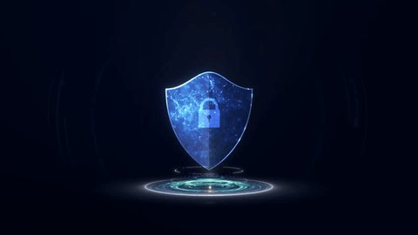
What is Data Security? Why Does It Matter?
Definition: Protecting digital data from unauthorized access, corruption, or theft throughout its lifecycle.
The CIA Triad:
• Confidentiality — Only authorized access
• Integrity — Data remains accurate
• Availability — Data accessible when needed
Real-World Impact:
• Average data breach cost: $4.99M (IBM 2025)
• Global cybercrime: $13.82T projected by 2028
87% of organizations identify AI-related vulnerabilities as their fastest-growing cyber risk (WEF 2026)
04

Slide 5
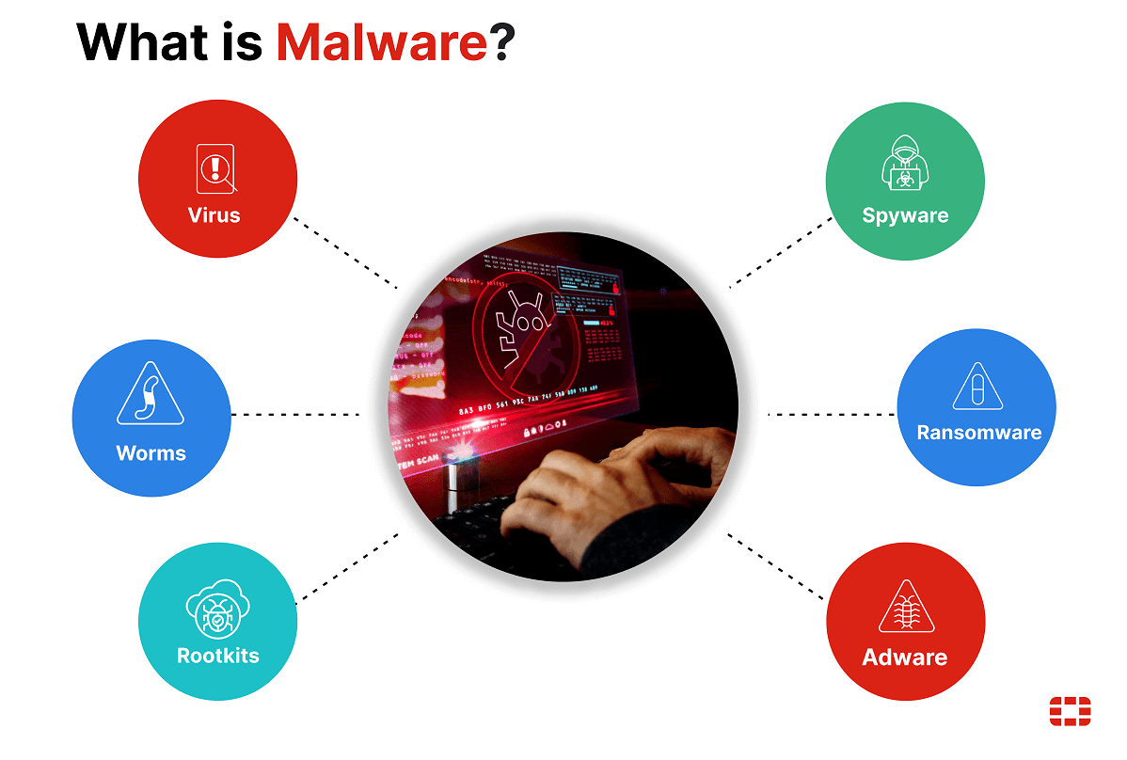
Malware: The Silent Digital Threat
Definition: Malicious software designed to damage, disrupt, or gain unauthorized access to systems.
Key Subtypes:
• Viruses — Self-replicating, attach to files
• Worms — Spread autonomously across networks
• Trojans — Disguise as legitimate software
• Spyware — Secretly monitors user activity
• Cryptojacking — Uses systems to mine crypto
Scale: 560,000+ new threats detected daily; 1B+ programs circulating globally.
Real-World Example: WannaCry Ransomware (2017) — Infected 200,000+ computers across 150 countries in 4 days, exploiting Windows SMB vulnerability. Total damages: ~$4 billion.
05

Slide 6
Phishing & Social Engineering: The Human Factor
Phishing Types
Social Engineering
• Spear Phishing — Targets specific individuals with personalized messages
• Whaling — Targets high-level executives (C-suite)
• Smishing — SMS/text message-based attacks
• Vishing — Voice call-based deception
90%+ of cyberattacks start with phishing. 3.4B phishing emails sent daily.
Psychological manipulation to trick users into making security mistakes.
Tactics: Pretexting, Baiting, Quid pro quo
Prevention: Verify senders, check URLs, enable MFA, train employees regularly.
Real-World Case: 2016 DNC Email Breach — Russian hackers used spear phishing emails to steal credentials, accessing 60,000+ emails and influencing the U.S. election.
06

Slide 7
Advanced Threats: Ransomware, DDoS & Insider Attacks
Ransomware
DDoS Attacks
Insider Threats
Encrypts victim's data and demands payment for decryption.
78% of companies experienced ransomware in the past year.
Double Extortion: Encrypt + leak threat.
Floods systems with massive traffic to disrupt services.
Often a smokescreen for other attacks.
Cost: $5,600/min of downtime.
Malicious or accidental harm from within the organization.
Cost: $4.99M per incident.
Supply chain: 267 days to resolve.
Emerging Threats in 2026:
• AI-Powered Attacks — Deepfakes, automated phishing
• Supply Chain — 2nd most common vector (IBM 2025)
• IoT Vulnerabilities — Billions of entry points
07

Slide 8
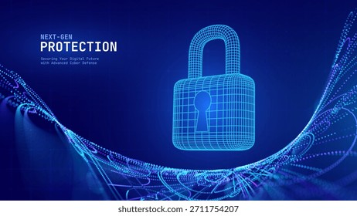
Encryption: The Foundation of Data Protection
Definition: Converting plaintext into ciphertext to prevent unauthorized access.
Two Main Types:
• Symmetric — Same key for encryption and decryption (AES-256)
• Asymmetric — Public/private key pair (RSA, ECC)
Data States:
• At Rest — Stored data (full-disk encryption)
• In Transit — Moving data (TLS 1.3, HTTPS)
Real-World: Stolen laptop with full-disk encryption = no data breach.
Feature | Symmetric | Asymmetric
Keys | 1 shared key | Public + Private
Speed | Fast | Slower
Use Case | File encryption | SSL/TLS, email
AES-256 is used by the U.S. government for TOP SECRET information.
08

Slide 9
Backup & Recovery: Your Safety Net
The 3-2-1 Backup Rule
3 copies of data · 2 different media types · 1 offsite copy
Full Backup
Incremental
Differential
Complete copy of all data. Most comprehensive but slowest. Best for initial setup.
Only changes since last backup. Fast and efficient. Requires full + all incrementals to restore.
Changes since last full backup. Balance between speed and restore simplicity.
Key Metrics: RTO = Max acceptable downtime | RPO = Max acceptable data loss
93% of companies experiencing major data loss without backups never fully recover.
09

Slide 10
Access Control, Firewalls & Security Best Practices
Access Control Types
Firewall Types
• DAC — Discretionary (owner decides)
• MAC — Mandatory (system-enforced)
• RBAC — Role-Based (job function)
Least Privilege: Give minimum access needed.
• Packet-filtering — Checks packet headers
• Stateful — Tracks active connections
• Proxy — Intermediary gateway
• NGFW — Deep packet inspection + IPS
Multi-Factor Authentication (MFA) — Requires 2+ verification factors. Reduces account compromise by 99.9%.
Security Best Practices
Regular updates · Password policies · Security training · Network segmentation · IDS · Audits · Incident response
10

Slide 11
Python Code: Encryption & Password Security
Fernet Symmetric Encryption
Password Hashing with bcrypt
from cryptography.fernet import Fernet
# Generate a key
key = Fernet.generate_key()
cipher = Fernet(key)
# Encrypt
msg = b"Secret Data"
token = cipher.encrypt(msg)
# Decrypt
original = cipher.decrypt(token)
import bcrypt
# Hash a password
password = b"user_password"
salt = bcrypt.gensalt(rounds=12)
hashed = bcrypt.hashpw(password, salt)
# Verify password
valid = bcrypt.checkpw(password, hashed)
print(f"Valid: {valid}")
Secure Random Password Generator
import secrets, string
def generate_password(length=16):
alphabet = string.ascii_letters + string.digits + "!@#$%^&*"
password = ''.join(secrets.choice(alphabet) for _ in range(length))
return password
print(generate_password()) # Output: k9#mP2$vLq5@nX8w
11

Slide 12
02
Lecture 20: Modern Computing
Virtualization, Cloud, Deep/Dark Web, Bitcoin, VR/AR, and IoT

Slide 13
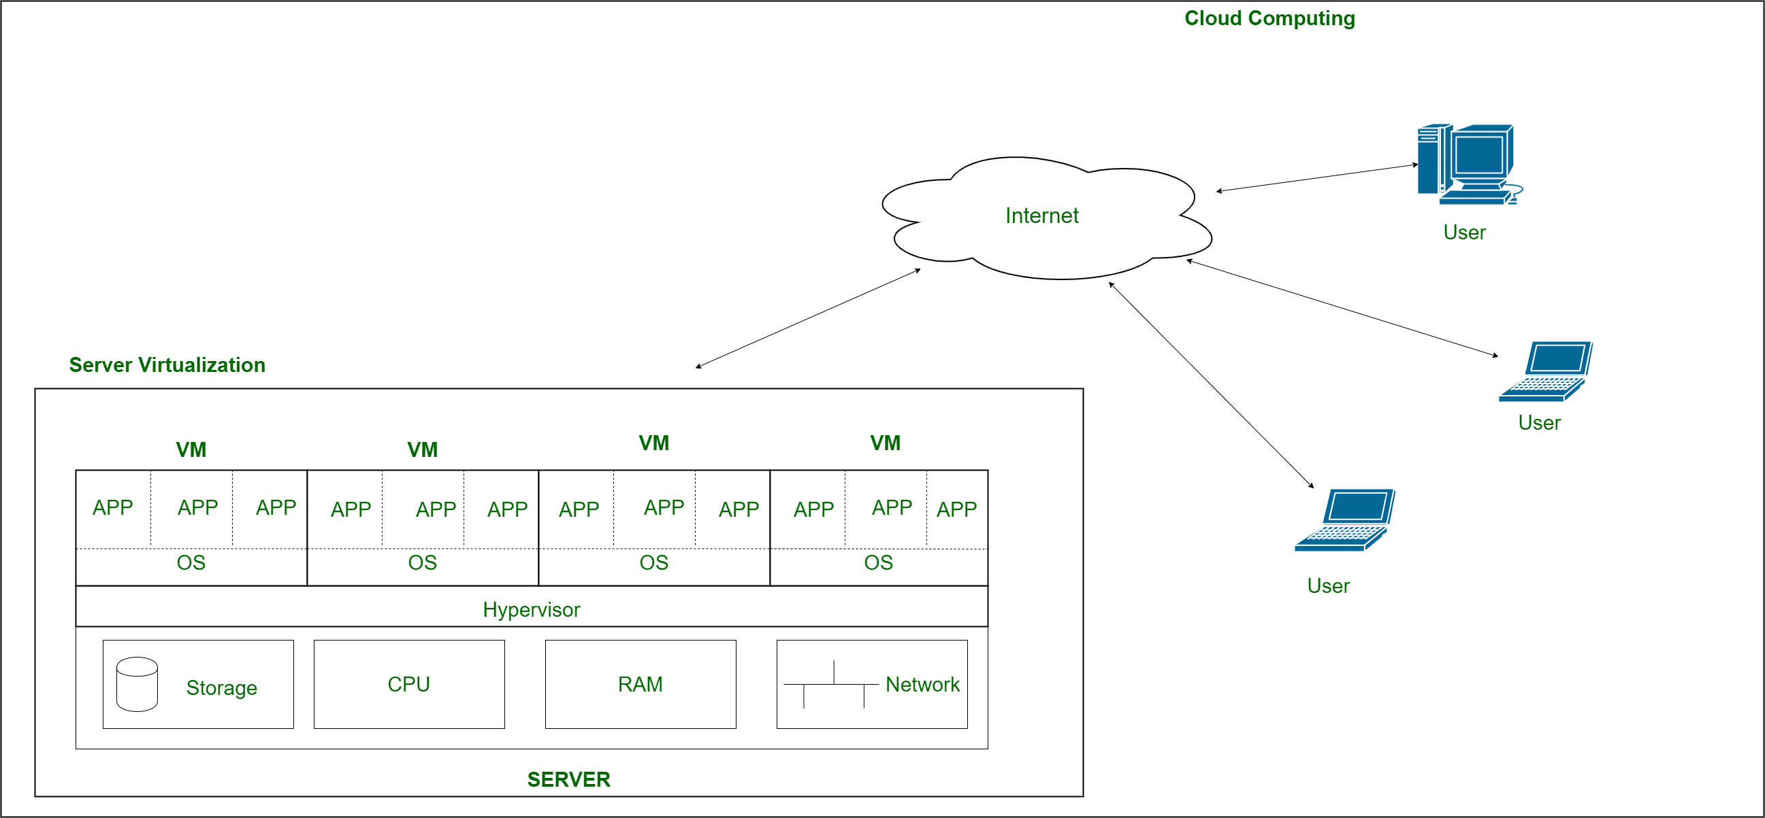
Virtualization: Multiple Systems on One Machine
Definition: Creating virtual versions of computing resources (servers, storage, networks) that run on physical hardware, enabling multiple OS instances to coexist.
Type 1 — Bare Metal
Type 2 — Hosted
Runs directly on hardware without a host OS. Best for enterprise data centers.
Examples: VMware ESXi, Microsoft Hyper-V, Xen, KVM
Runs on top of a host OS. Ideal for development, testing, and personal use.
Examples: VMware Workstation, VirtualBox, Parallels
Key Benefits:
• Resource optimization & cost reduction
• Isolation & security between VMs
• Easy testing & rapid deployment
• Disaster recovery & high availability
13

Slide 14
Virtualization in Action: Real-World Examples
Server Virtualization
Multiple OS on one physical server. VMware vSphere, Citrix Hypervisor.
Desktop Virtualization (VDI)
Centralized desktop management. VMware Horizon, Citrix DaaS.
Network Virtualization (SDN)
Abstract network resources. VMware NSX, Cisco ACI.
Storage Virtualization
Pool physical storage. SAN, NAS, VMware vSAN.
Application Virtualization
Run apps without install. Microsoft App-V, VMware ThinApp.
Containerization
Lightweight VMs alternative. Docker, Kubernetes.
Aspect | VMs | Containers | Emulation
What it virtualizes | Hardware | Operating System | CPU/Architecture
14

Slide 15
Emulation: Recreating Hardware in Software
Definition: Software that mimics hardware of another system to run software that is incompatible with the host machine.
Virtualization vs Emulation
Common Use Cases
Feature | Virtualization | Emulation
Hardware Use | Uses host directly | Simulates hardware
Compatibility | Guest = Host arch | Any architecture
Performance | Near-native | Slower overhead
• Running retro games (Atari, NES, Commodore 64)
• Cross-platform development
• Legacy software support
• Digital preservation of old systems
• Mobile app testing (Android on PC)
Popular Emulators
QEMU
Cross-platform system emulator
Dolphin
GameCube & Wii emulator
BlueStacks
Android on PC emulator
MAME
Arcade game emulator
15

Slide 16
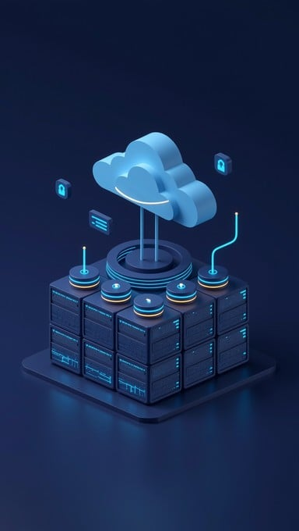
Cloud Computing: Computing as a Utility
Definition: Delivery of computing services (servers, storage, databases, networking, software) over the internet. "Like electricity — you don't own the power plant, you pay for what you use."
Service Models
• IaaS — Infrastructure as a Service (rent servers, storage)
• PaaS — Platform as a Service (rent dev environment)
• SaaS — Software as a Service (rent ready-to-use apps)
Deployment Models:
Public · Private · Hybrid · Community
Major Cloud Providers (2025)
AWS
32% market share
Azure
23% market share
Google Cloud
10% market share
Others
IBM, Oracle, Alibaba (35%)
16

Slide 17
IaaS vs PaaS vs SaaS: Understanding the Layers
Feature | IaaS | PaaS | SaaS
What you rent | Servers, storage, network | Development platform | Ready-to-use software
Provider manages | Infrastructure | Runtime, middleware | Everything
You manage | OS, apps, data | Applications, data | Just your data
Examples | AWS EC2, Azure VM | Heroku, App Engine | Gmail, Salesforce
Customization | Highest | Moderate | Lowest
Analogy | Renting a kitchen | Meal kit delivery | Dining at a restaurant
SaaS — Applications (Gmail, Slack, Zoom, Salesforce)
PaaS — Platform (OS, Runtime, Middleware, Databases)
IaaS — Infrastructure (Servers, Storage, Networking, Virtualization)
17

Slide 18
Cloud Computing: Pros, Cons & Real-World Impact
Advantages
Disadvantages
• Cost Reduction — Up to 35% yearly savings
• Scalability — Handle traffic spikes instantly
• Disaster Recovery — Multi-region backup
• Global Reach — CDN for low latency
• Auto Updates — Provider-managed patches
• Collaboration — 72% efficiency boost
77% of businesses use cloud services.
• Vendor Lock-In — 38% delay migration
• Internet Dependency — Azure 6hr outage 2023
• Unpredictable Costs — 20-30% bill increases
• Security Concerns — Capital One: $150M breach
• Compliance Complexity — GDPR, HIPAA rules
• Performance Issues — Multi-tenant variability
Downtime cost: $5,600/min
Real-World Success: Netflix uses AWS edge servers to reduce video buffering by 50%. Spotify reduced release cycles by 30% using cloud infrastructure.
18

Slide 19
The Deep Web: Beyond Search Engines
Definition: Parts of the internet not indexed by standard search engines. Estimated to be 400-550x larger than the surface web. Not inherently illegal — mostly legitimate content.
What's in the Deep Web?
The Web Iceberg
• Academic databases (JSTOR, PubMed)
• Legal documents (LexisNexis)
• Medical records & scientific reports
• Subscription-based content
• Private corporate intranets
• Government resources
• Online banking portals
Surface Web (~0.2% — Google, Wikipedia)
Deep Web (~99.8%)
Dark Web (~0.01% — Tor .onion)
Access: Requires direct URL, login credentials, or specialized search tools. Most deep web content is completely legal.
19

Slide 20
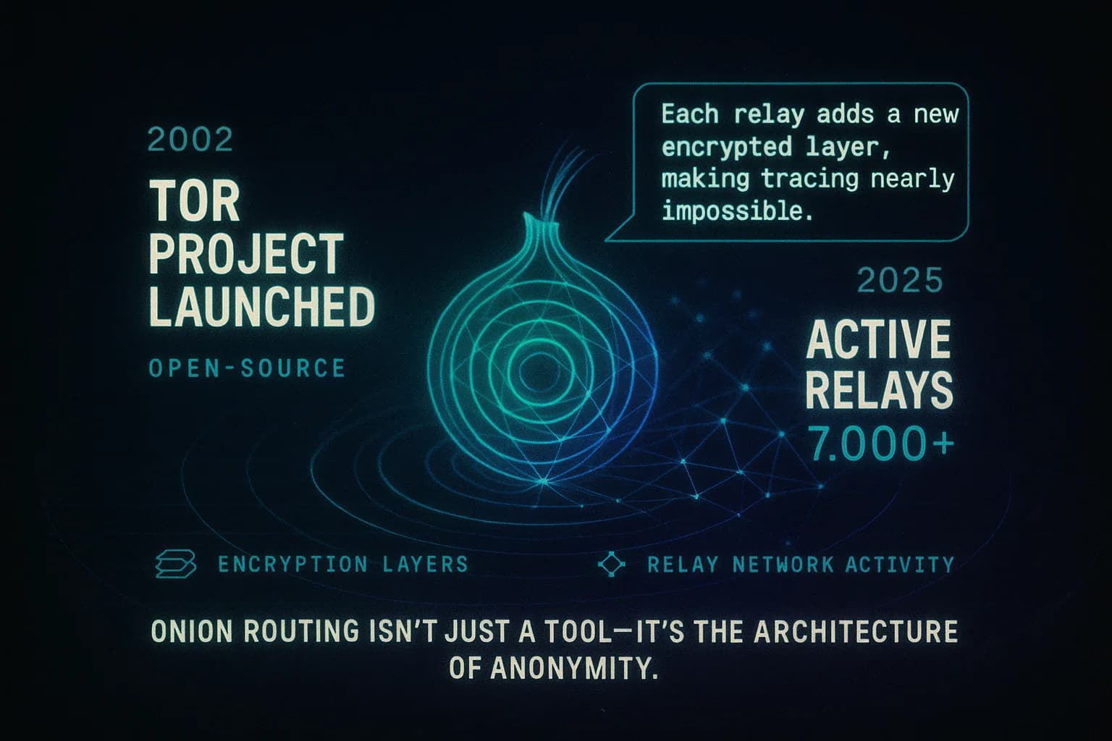
The Dark Web: The Hidden Underbelly
Definition: A small portion of the deep web (~0.01%) intentionally hidden, requiring special software (Tor) to access. Characterized by anonymity and encrypted communications.
How Tor Works
Key Characteristics:
• Anonymity — Users and operators hidden
• Encrypted — Communications secured
• .onion sites — Only accessible via Tor
• Cryptocurrency — Bitcoin for transactions
Legitimate Uses:
• Whistleblowers, journalists, activists
Tor uses layered encryption and 7,000+ relays.
Important: While the dark web has legitimate uses, it also hosts significant illegal activity. Accessing it carries legal and security risks.
20

Slide 21
Dark Web: Risks, Cases & Staying Safe
Illegal Activities
Risks of Accessing
• Drug trafficking (Silk Road: $1.2B)
• Weapons and counterfeit goods
• Stolen data markets
• Hacking services and malware
• Malware — Drive-by downloads
• Scams — No recourse
• Legal risks — Law enforcement monitors
• Identity exposure
Major Law Enforcement Takedowns
2013
Silk Road shut down by FBI
2017
AlphaBay seized by FBI
2022
Hydra Market shut down
Ongoing
FBI, Europol monitoring
Staying Safe: Never visit without purpose · Use VPN + Tor · Don't download files · Never share personal info · Understand legal risks
21

Slide 22
Bitcoin: Digital Money Powered by Blockchain
Definition: First decentralized cryptocurrency, created by Satoshi Nakamoto (2008 whitepaper, 2009 launch).
Key Features:
• Decentralized — No central authority
• Limited Supply — Only 21 million coins
• Pseudonymous — Wallet addresses
• Immutable — Cannot be reversed
Real-World: El Salvador adopted Bitcoin as legal tender in 2021.
How Blockchain Works
A blockchain is a distributed digital ledger.
Process:
1. Transaction broadcast to network
2. Miners verify using cryptography
3. Transactions form a block
4. Block added to the chain
Bitcoin Wallet Types
Hot Wallet
Connected to internet. (Coinbase, MetaMask)
Cold Wallet
Offline storage. (Ledger, Trezor)
Paper Wallet
Private key printed on paper
Brain Wallet
Key from memorized passphrase
22

Slide 23
Bitcoin Mining, Value & Global Impact
What is Mining?
Verifying transactions and adding them to the blockchain.
Miners solve puzzles (Proof of Work) for rewards.
Difficulty adjusts every 2,016 blocks.
~150 TWh
Annual energy use (like Argentina)
~$95K
Bitcoin price in 2025 (peaked at $69K in 2021)
21M
Maximum supply cap. Currently ~19.7M mined.
$0.003
First recorded price (2010) vs ~$95,000 today
Environmental: Shift to renewable mining (hydro, solar). Iceland hosts major green farms.
23

Slide 24
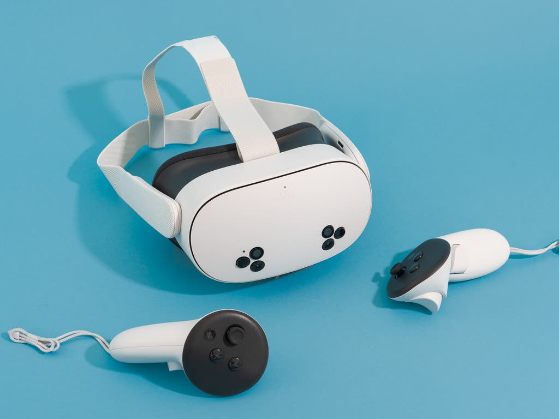
Virtual Reality: Stepping Into Digital Worlds
Definition: Creates a fully simulated environment, replacing the real world.
Key Characteristics:
• Full immersion with 360° view
• Spatial audio, hand tracking, haptics
Market: $165B projected by 2030
VR Applications
Gaming
Beat Saber, Half-Life: Alyx
Healthcare
Surgical training +230%
Education
Virtual field trips
Real Estate
Virtual property tours
Military
Combat simulation
Fitness
VR workouts
Popular VR Headsets: Meta Quest 3 · Apple Vision Pro · PlayStation VR2 · HTC Vive Pro 2 · Valve Index
24

Slide 25

Augmented Reality: Enhancing the Real World
Definition: Overlays digital information onto the real world.
Key Characteristics:
• Real-world overlay with digital elements
• Interactive and context-aware
• Accessible via smartphones and smart glasses
Market: $198B projected by 2030
AR Applications
Education
Quiver 3D, Google Lens
Healthcare
AccuVein vein mapping
Manufacturing
Boeing -25% errors
Retail
IKEA Place preview
Navigation
AR directions in Maps
Social
Snapchat filters
AR Hardware: Microsoft HoloLens 2 · Magic Leap 2 · Apple Vision Pro · Google Glass Enterprise · Smartphone AR (ARKit, ARCore)
25

Slide 26
VR vs AR: Understanding the Differences
Feature | Virtual Reality (VR) | Augmented Reality (AR)
Immersion | Fully immersive — replaces real world | Partially immersive — overlays digital
Environment | Completely digital world | Real world + digital overlay
Hardware | VR headset required | Smartphone, tablet, or glasses
Use Cases | Gaming, training, simulation | Navigation, shopping, repair
Market 2030 | $165 billion | $198 billion
Examples | Meta Quest 3, PS VR2 | HoloLens, Google Lens
The Extended Reality (XR) Spectrum
Real World ························· AR ········ MR ········ VR ························· Virtual World
MR — Mixed Reality: Blends real and virtual worlds (HoloLens 2)
XR — Extended Reality: Umbrella term for VR, AR, and MR
Future: Apple Vision Pro and Meta Orion point to merged reality
26

Slide 27
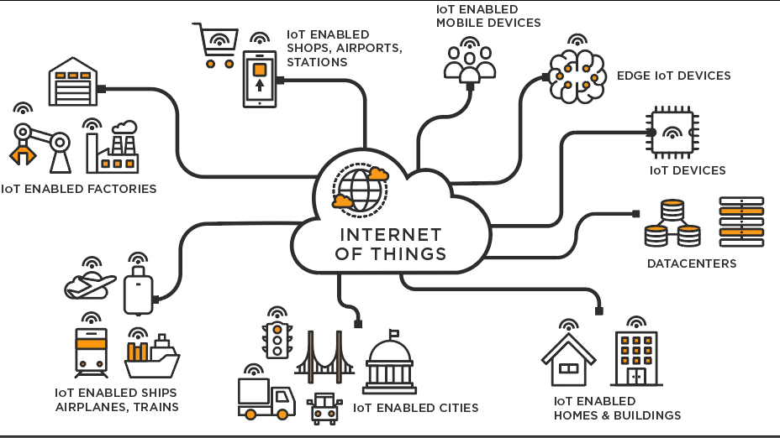
Internet of Things: A World of Connected Devices
Definition: Network of physical objects embedded with sensors, software, and connectivity to exchange data. 75+ billion devices expected by 2025.
IoT Architecture
Application Layer — Data processing, analytics, user interfaces, cloud services
Network Layer — Connectivity: Wi-Fi, Bluetooth, 5G, LoRaWAN, Zigbee
Perception Layer — Sensors, actuators, cameras, RFID tags, GPS
How It Works
Devices collect data → Transmit to cloud → Process & analyze → Trigger actions
27

Slide 28
IoT Applications: Transforming Industries
Smart Home
Nest thermostat, Philips Hue, Ring doorbell, smart fridges
Healthcare
Fitbit, Apple Watch, remote patient monitoring, smart pill dispensers
Agriculture
Precision farming, soil sensors, drone monitoring, livestock tracking
Smart Cities
Traffic management, smart bins, air quality monitoring, smart parking
Industrial IoT (IIoT)
Predictive maintenance, asset tracking, supply chain optimization
Transportation
Fleet management, connected cars (Tesla OTA), logistics tracking
Global IoT Market: $1.1 trillion by 2026 · Connected Devices: 75+ billion by 2025 · Every second, 127 new devices connect to the internet.
28

Slide 29
IoT: Challenges, Security & the Future
Key Challenges
Security Measures
• Security — Mirai botnet: 600K+ devices
• Privacy — Data collection concerns
• Interoperability — Different standards
• Scalability — Billions of devices
• Device authentication & encryption
• Regular firmware updates
• Network segmentation (IoT VLAN)
• Strong password policies
Future Trends
AI + IoT
AIoT for intelligent automation and edge AI
5G IoT
Massive device connectivity with low latency
Edge Computing
Process data closer to devices, reduce latency
Digital Twins
Virtual replicas of physical systems
Green IoT
Energy harvesting sensors for sustainability
import paho.mqtt.client as mqtt # Python IoT sensor simulation using MQTT protocol
29

Slide 30
The Future is Connected
Stay Secure, Stay Curious, Stay Ahead
Data security is foundational to all technology
Modern computing is transforming how we live and work
Understanding both opportunities and risks is essential
Week 10 · Computing Fundamentals · 2026
LOGO

